Slide 1



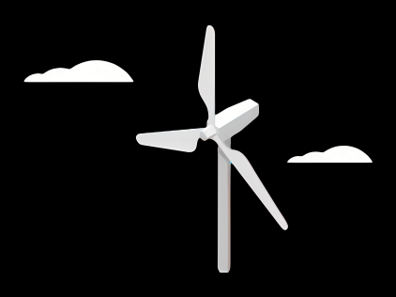
Rotor Hub And Pitch System
Group Members :
Dhruvin Kakdiya
Adharsh Pappinisseri Veedu
Muthu Thirunavukarasu
Syed Mohammed Sikandar
Week number : 02
Date: 30/09/2025
Supervisor: Prof. Peter Quell

Slide 2
Agenda
Comparison of Hub shape
Selection of Hub
Comparison of a pitch system
Selection of a pitch system
List of parts
Presented by: Adharsh Pappinisseri Veedu - 770483

Slide 3
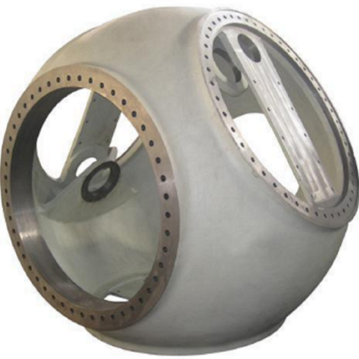
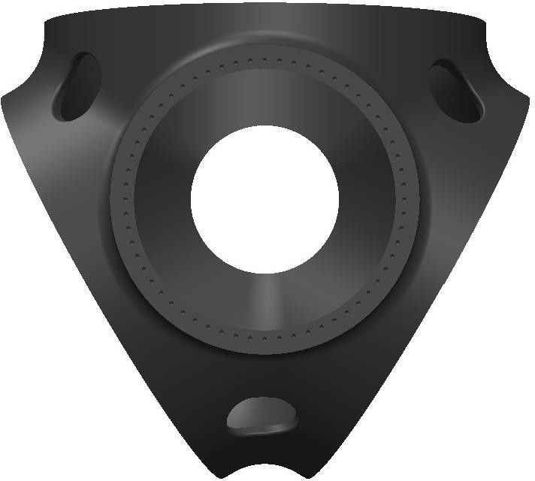
Shapes of Hub
Now a days there are two types of Hub shape is commonly use:
Star Shape Hub
Sphere Shape Hub

Slide 4
Rotor Hub Shape Comparison
Category | Star Shape Hub | Sphere Shape Hub | Result
Aerodynamic Efficiency | Moderate - more drag due to protrusions and edges | High - smoother surface, lower drag, reduced turbulence | Sphere Shape
Structural Simplicity | High - direct load paths, simple geometry | Moderate - curved shapes require complex internal support | Star Shape
Manufacturing Ease | Easy - simpler to cast, weld, or machine | Complex - harder to fabricate due to curves and internal transitions | Star Shape
Maintenance Access | Easy - accessible joints at blade roots | Harder - may require disassembly or special tools | Star Shape
Fatigue Resistance | Good - but stress concentrations at blade root junctions | Excellent - smoother load distribution reduces fatigue cracks | Sphere Shape
Weight | Lighter - less material due to simpler design | Heavier - more material for smooth integration and strength | Star Shape
Cost | Lower - materials, labor, and tooling costs are minimal | Higher - due to design and fabrication complexity | Star Shape
Suitability (Onshore) | Very suitable - proven and practical | Less common - unless specific goals are targeted | Star Shape
 |  | Overall for Optimus Syria | Star Shape

Slide 5
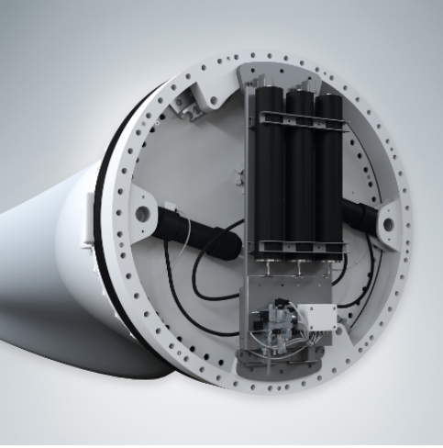
Hydraulic Pitch Control System
Uses Hydraulic fluid to change blade angle and offer high power density and fast reaction times
Preferred for Large turbines needing high torque and robust performance
Long lifespan but needs regular maintenance to prevent failures
Risk of fluid leaks with environmental impact

Slide 6
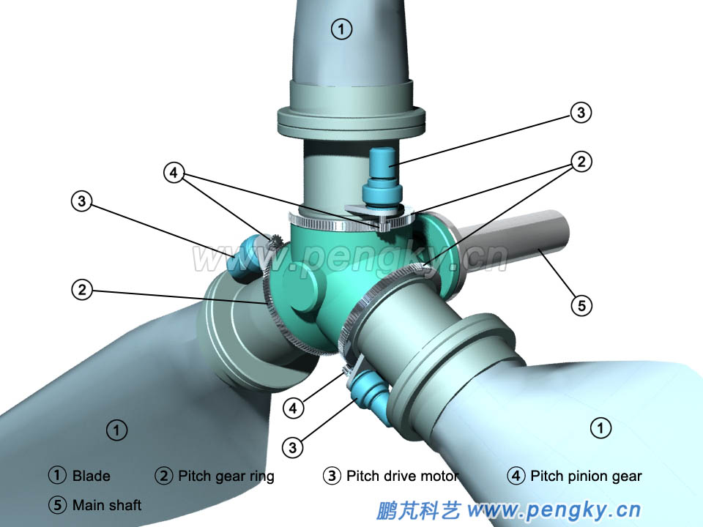
Electric Pitch Control System
Uses electric motors for blade pitch and delivers high control and accuracy
Low logistics
Higher energy efficiency and reduced environmental impact
Ideal for environmental sensitive or remote sites with limited maintenance resources

Slide 7
Weighted Evaluation of Pitch Control Systems
Criteria | Weightage | Electrical Pitch | Hydraulic Pitch
Low investment cost | 28% | 3 | 2
High torque | 10% | 2 | 3
Reliability | 14% | 3 | 3
Accuracy/Control process | 12% | 3 | 2
Low Maintenance effort | 14% | 3 | 1
Weight | 8% | 3 | 2
Low Energy Consumption | 8% | 3 | 1
Simple Design | 6% | 3 | 2
Sum | 100% | 84% | 64%

Slide 8
Why Choose Electric over Hydraulic?
Easier to service locally with standard electric skills and no need for hydraulic specialists
No Hydraulic oil→ no leaks or contamination risk in hot, dusty environment
Standard motor/controllers are widely available and cheaper to stock than hydraulic parts
Handles high ambient temperatures and dust reliably with IP-rated enclosures

Slide 9
List of parts
Hub
Pitch system
Pitch Gearbox
Pitch pinion
Pitch Bearing , Bearing cover, Cover Holder
Pitch motor
Batter & Battery Holder
Stiffening ring
Spinner
Spinner Connection Ring
Ladder
Safety Cabinets
Sealing ring

